Slide 1
Improving VANET Simulator In NS-3
Bradley Dupont
Michele Weigle

Slide 2
Outline
Introduction
Original Architecture
Updated Architecture
Future Work

Slide 3
Introduction
Vehicular Ad-Hoc Network (VANET)
Vehicle-to-Vehicle
Vehicle-to-Infrastructure
Many safety and commercial possibilities

Slide 4


Introduction
Have to test
Purchasing equipment expensive
Massive tests not feasible

Slide 5
Introduction
Simulation the only alternative
Traffic simulators work for Vehicles
Network simulators for Networks
Integration incomplete or insufficient

Slide 6
Introduction
NS-3 a powerful network simulator
Built-in mobility model
Mobility model can be extended

Slide 7
Original Architecture
Built by Arbabi, Weigle
Uses Intelligent Driver Model (IDM)
A driver-following model
Equation uses distance, velocity delta, and max acceleration and breaking
Uses MOBIL
A lane-change model
Uses information from IDM
Looks for a more free path in next lane vs. negative impact on following vehicle in next lane

Slide 8
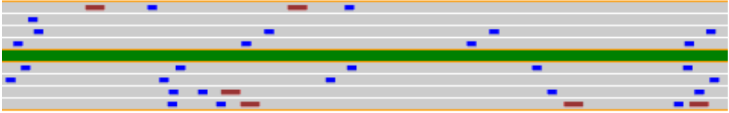
Original Architecture
One or Two Direction Highway
Highway has multiple Lanes
Vehicle Objects
Wifi node
Configurable IDM / MOBIL objects
Automatic or Manual Vehicle Creation
Customization hooks
Image from [Arbabi]

Slide 9
Original Architecture
Only one Highway
Only east/west
No intersections
Command-line config
Highway class difficult to maintain/extend

Slide 10
New Architecture
Maintain IDM and MOBIL
Omni-directional Highways
Connect Highways
Intersections especially important
Can influence traffic flow
Can quickly modify traffic density

Slide 11
New Architecture
Highway controlled by HighwayProject
Highways connect to Highways
Vehicle creation externalized

Slide 12
New Architecture
Four different types of connections
Straight, Left, Right, Back
Highway can have any combination on any lane
Highways look for Vehicles recursively

Slide 13


New Architecture
Highway handles Traffic Lights
Traffic Lights are special Obstacles
Vehicles that cannot stop in time pass through Traffic Lights
TrafficLightGenerator utility created

Slide 14
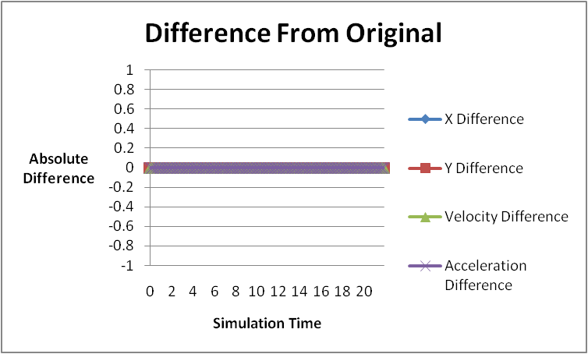
New Architecture
Needed to verify IDM/Mobil
Constructed test scenario
Ran on both architectures
Compared data

Slide 15
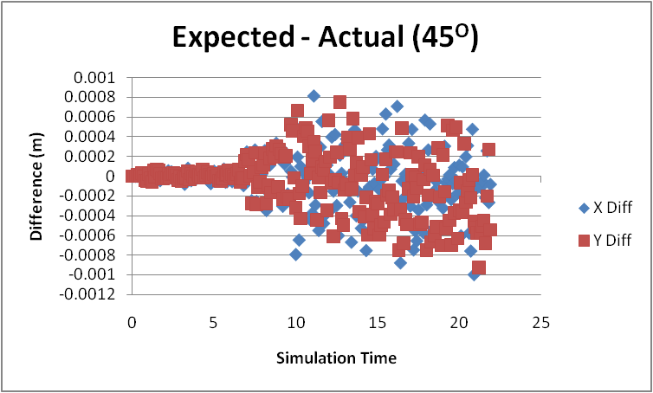
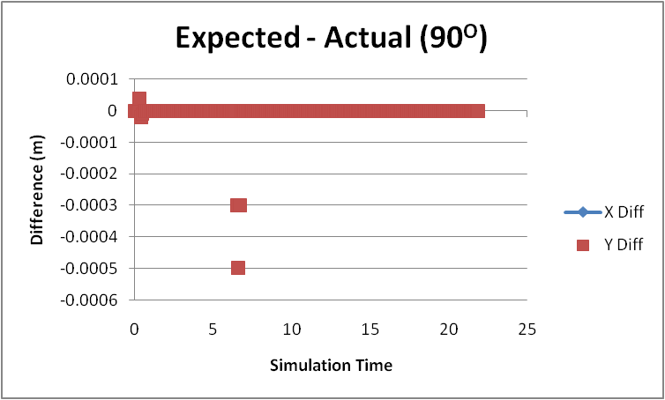
New Architecture
Needed to verify omni-directionality
Ran same test scenario
Pointed Highway in different directions
45, 90, 135, 180, 225, 270, 315 degrees
Compared results to expected

Slide 16
New Architecture
Code for both versions available for free on google code:
http://code.google.com/p/ns-3-highway-mobility/downloads/list

Slide 17
Future Work
Highway editor
Doing the configuration by hand is time-consuming and error-prone
Better customization hooks
Current Vehicle control is limited to one call per step
Upgrade Highways to curves
Straight lines effective, but not perfect
Add third dimension to travel

Slide 18
Thank You
Questions?

Slide 19
References
[Arbabi] - Arbabi, H., and Weigle, M. 2010. Highway Mobility and Vehicular Ad-Hoc Networks in NS-3, In Proceedings of the 2010 Winter Simulation Conferance

Slide 20
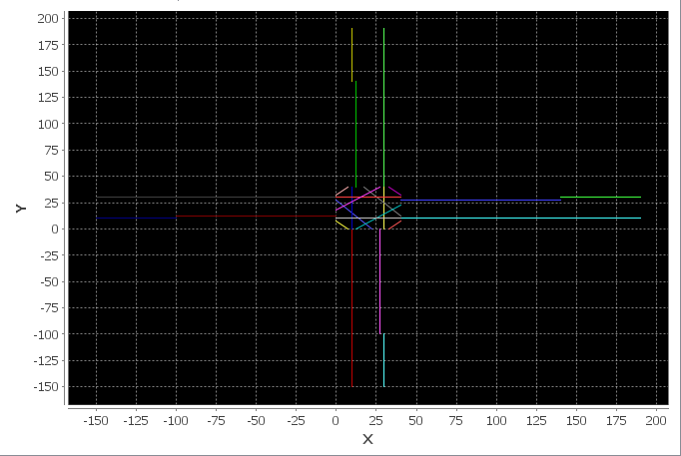
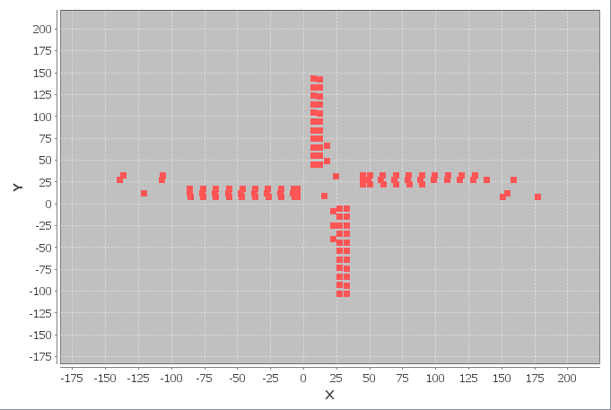
Example
24 Highways
4 VehicleGenerators
1 TrafficLight Generator

Slide 21
Example
<highway
highwayId="1" numberOfLanes="2" direction="0.0" length="50.0"
startX="-150.0" startY="10.0" leftTurnSpeed="2.2352”
rightTurnSpeed="2.2352" laneWidth="5.0">
<frontHighways>
<highwayConnection highwayId="2" laneOffset="0" offset="-1"/>
</frontHighways>
</highway>
….
<vehicleGenerator
highwayId="1" wifiConfigId="1" flow="1.0" lowVelocity="18.1168"
highVelocity="23.1168" minGap="45.0" penetrationRate="100.0">
<destination weight="0.3" destinationId="22"/>
<destination weight="0.3" destinationId="16"/>
<destination weight="0.4" destinationId="4"/>
</vehicleGenerator>
Library for loading XML is TinyXML: http://www.grinninglizard.com/tinyxml/

Slide 22
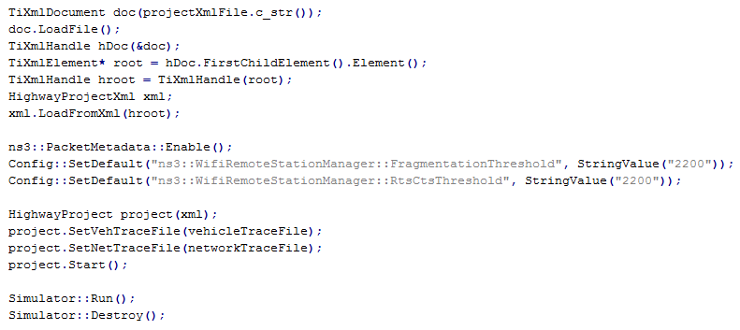
Example

